Slide 1
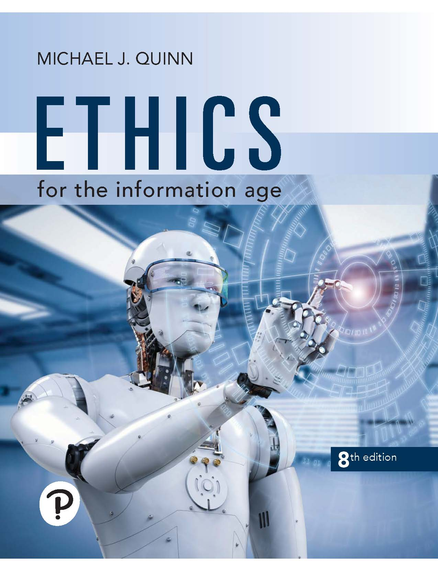
Ethics for the Information Age
Eighth Edition
Chapter 9
Professional Ethics
Copyright © 2020, 2017, 2015 Pearson Education, Inc. All Rights Reserved
Notes:
If this PowerPoint presentation contains mathematical equations, you may need to check that your computer has the following installed:
1) MathType Plugin
2) Math Player (free versions available)
3) NVDA Reader (free versions available)

Slide 2
Learning Objectives
9.1 Introduction
9.2 How well developed are the computing professions?
9.3 Software Engineering Code of Ethics
9.4 Analysis of the Code
9.5 Case studies
9.6 Whistle-blowing

Slide 3
9.1 Introduction

Slide 4
9.1 Introduction
Informally, profession a vocation requiring…
High level of education
Practical experience
We pay professionals well
Doctors
Lawyers
We trust professionals to…
Correctly ascertain and treat problems
Take actions for the good of their clients

Slide 5
9.2 How Well Developed are the Computing Professions?

Slide 6
Characteristics of a Profession
Initial professional education
Accreditation
Skills development
Certification
Licensing
Professional development
Code of ethics
Professional society

Slide 7
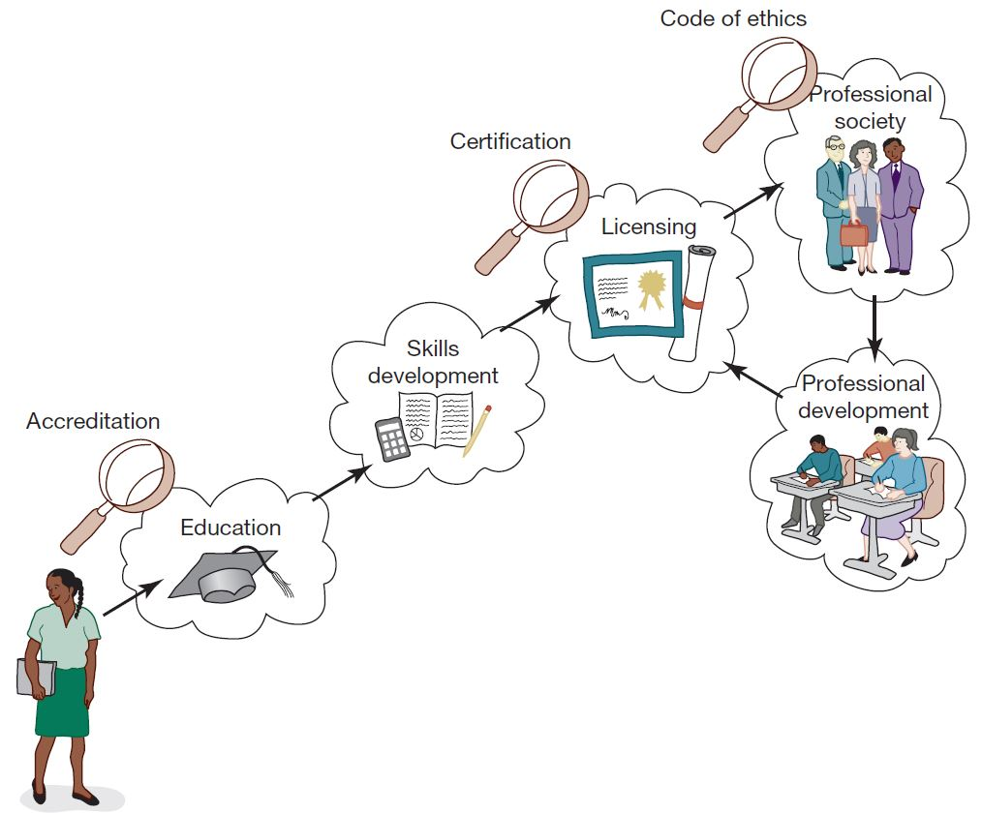
Attributes of a Mature Profession
A mature profession has eight attributes that enable it to certify new members and support existing members.

Slide 8
Case Study: Certified Public Accountants
Bachelor’s degree
150+ semester hours
24+ hours of accounting-related classes
Two years’ experience working under supervision of C P A
C P A exam
To retain certification
Continuing education
Follow code of ethics

Slide 9
How Do Computer-Related Careers Stack Up?
Certification and licensing not required
College degree not required
Apprenticeship not required
Membership in professional society optional
No specific requirements for continuing education
Most computer programmers, system analysts, etc. are part of teams

Slide 10
Status of Certification and Licensing
Software engineer: someone engaged in development or maintenance of software, or teaches in this area
Path to certification was attempted: similar to path taken by engineers in other disciplines, such as civil engineering
Four years of post-college work experience
Pass Fundamentals of Engineering (F E) exam
Pass discipline-specific Principles and Practice of Engineering (P E) exam
Only 81 people nationwide took exam in first five years; exam has been discontinued

Slide 11
Ability to Harm Public
Many computer professionals hold responsibilities similar to those held by members of mature professions
Therac-25 killed or gravely injured at least six people
Millions rely upon software rather than accountants to prepare their tax returns
Millions of people rely on system administrators to keep their work-related information secure

Slide 12
The Importance of Taking Personal Responsibility
The ability to cause harm to members of the public is a powerful reason why those in computer-related careers must act according to ethical principles. Without universal certification and licensing and other components of a well-developed profession to rely upon, those in computer-related careers must take more personal responsibility for developing their ethical decision-making skills.

Slide 13
9.3 Software Engineering Code of Ethics

Slide 14
Preamble of Code
Software engineers have opportunities to do good or do harm
Software engineers ought to be committed to doing good
Eight principles identify key ethical relationships and obligations within these relationship
Code should be seen as a whole, not a collection of parts
Concern for the public interest is paramount

Slide 15
Eight Principles Identify Morally Responsible Relationships
Public
Client and employer
Product
Judgment
Management
Profession
Colleagues
Self

Slide 16
Act Consistently with Public Interest
1.01 “Accept full responsibility for own work”
1.02 Balance competing interests
1.03 Approve software only if it is safe
1.04 Disclose actual/potential dangers
1.05 “Cooperate in efforts to address” public concerns
1.06 “Be fair and avoid deception in all statements”
1.07 Consider factors that diminish access to software
1.08 “Volunteer professional skills to good causes”

Slide 17
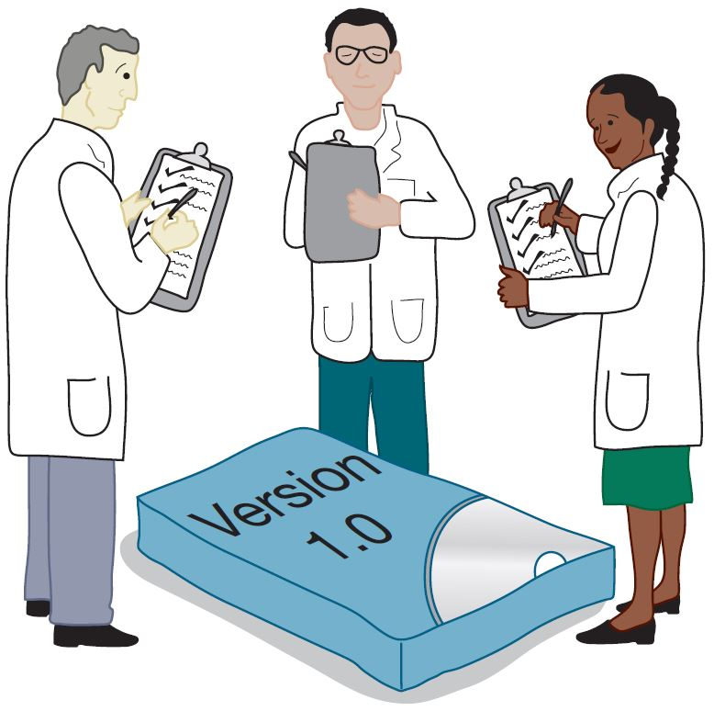
Clause 1.03 Approve Software Only If It Is Safe

Slide 18
Act in Best Interest of Client, Employer
2.01 Act within areas of competence
2.02 Don’t use software obtained illegally
2.03 Only use property in authorized ways
2.04 Ensure documents are approved
2.05 Respect confidentiality
2.06 Promptly report problems with project
2.07 Report issues of social concern
2.08 Refuse outside work detrimental to job
2.09 Put employer’s/client’s interests first, unless overriding moral concern

Slide 19
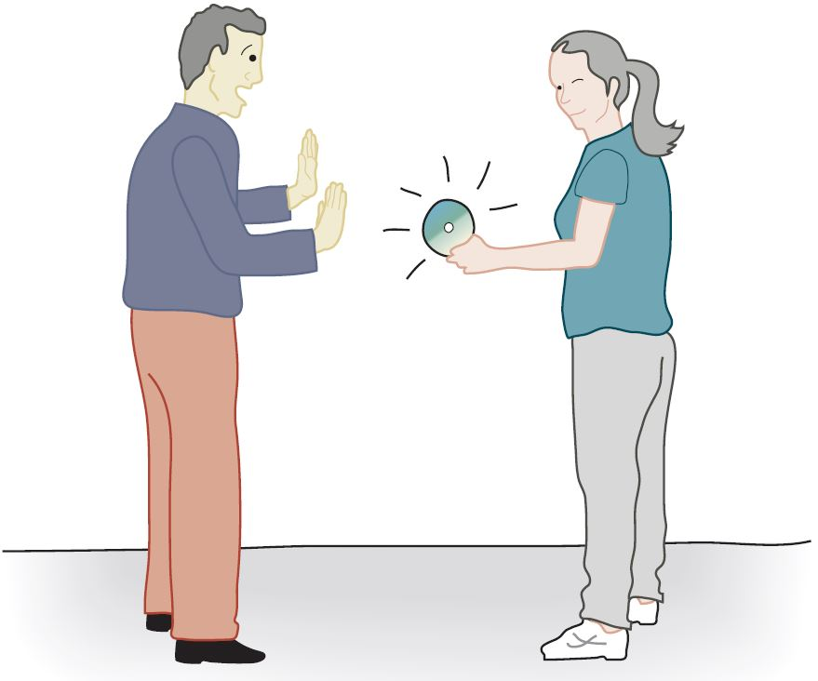
Clause 2.02 Don’t Use Software Obtained Illegally

Slide 20
Ensure Products Meet Highest Standards (1 of 2)
3.01 Aim for “high quality, acceptable cost and a reasonable schedule,” making trade-offs clear
3.02 “Ensure proper and achievable goals”
3.03 Face up to “ethical, economic, cultural, legal and environmental” issues
3.04 Ensure you are qualified for proposed work
3.05 Use appropriate project methodologies
3.06 Follow the most appropriate professional standards
3.07 “Strive to fully understand the specifications”
3.08 Ensure the specifications are correct and approved

Slide 21
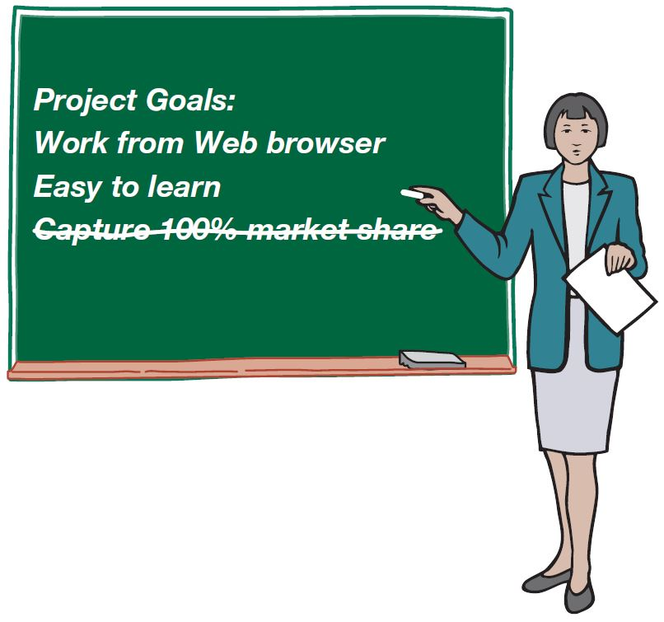
Clause 3.02 Ensure Proper and Achievable Goals

Slide 22
Ensure Products Meet Highest Standards (2 of 2)
3.09 “Ensure realistic quantitative estimates of cost, scheduling, personnel, quality and outcomes”
3.10 “Ensure adequate testing, debugging, and review of software and related documents”
3.11 “Ensure adequate documentation”
3.12 Develop software and documents that respect privacy of those affected by software
3.13 Use only accurate data appropriately acquired
3.14 Maintain data integrity
3.15 Use same standards for software maintenance as software development

Slide 23
Maintain Integrity in Professional Judgment
4.01 “Temper all technical judgments by the need to support and maintain human values”
4.02 Understand and agree with documents before endorsing them
4.03 Remain objective when evaluating software or related documents
4.04 Do not engage in deceptive financial practices
4.05 Disclose conflicts of interest
4.06 Do not participate in decisions in which you, your employer, or your client has a potential conflict of interest

Slide 24
Promote Effective Project Management (1 of 2)
5.01 Ensure good project management procedures
5.02 Ensure software engineers know standards
5.03 Ensure software engineers know policies and procedures for protecting confidential information
5.04 Take employees’ abilities into account before assigning work
5.05 Ensure reasonable estimates are made
5.06 Give full and accurate information to potential employees

Slide 25
Promote Effective Project Management (2 of 2)
5.07 Pay employees fairly
5.08 Do not unjustly prevent a qualified person from taking a job
5.09 Work out fair intellectual property agreements
5.10 Provide employees charged with misconduct due process
5.11 Do not ask someone to do anything violating the Code
5.12 “Do not punish anyone for expressing ethical concerns about a project”

Slide 26
Advance the Profession (1 of 2)
6.01 Help create an environment supporting ethical conduct
6.02 “Promote public knowledge of software engineering”
6.03 Participate in professional activities
6.04 Support others who are trying to follow this Code
6.05 Do not promote self-interest at expense of profession, client, or employer
6.06 Obey all laws unless there is an overriding public interest
6.07 Do not deceive others regarding the characteristics of software

Slide 27

Clause 6.01 Help Create an Environment Supporting Ethical Conduct

Slide 28
Advance the Profession (2 of 2)
6.08 Take responsibility for finding, correcting, and reporting errors in software and documentation
6.09 Ensure others know you are committed to the Code and what that means
6.10 Do not associate with businesses and organizations that are in conflict with Code
6.11 Understand violating the Code is inconsistent with being a professional
6.12 Share concerns about Code violations with the people involved
6.13 “Blow the whistle” when no alternative to reporting significant Code violations

Slide 29
Be Fair to and Supportive of Colleagues
7.01 “Encourage colleagues to adhere to this Code”
7.02 “Assist colleagues in professional development”
7.03 Give others the credit they deserve
7.04 Be objective when reviewing the work of others
7.05 Give colleagues a fair hearing
7.06 Help colleagues remain aware of work practices
7.07 Do not unfairly interfere with another’s career, but protect the public interest
7.08 Bring in experts for situations outside your own area of competence.

Slide 30
Participate in Lifelong Learning
8.01 Stay current with developments in field
8.02 Improve ability to create high quality software
8.03 Improve ability to produce high quality documentation
8.04 Improve understanding of software and documentation used in work
8.05 Improve knowledge of relevant standards
8.06 Improve knowledge of this Code and its application
8.07 Do not treat others unfairly because of prejudices
8.08 Do not influence others to break the Code
8.09 “Recognize that personal violations of this Code are inconsistent with being a professional software engineer”

Slide 31

Clause 8.02 Improve Ability to Create High Quality Software

Slide 32
9.4 Analysis of the Code

Slide 33
Analysis of Preamble
No mechanical process for determining if an action is right or wrong
Should not take an overly legalistic view of the Code
If Code doesn’t forbid something, that doesn’t mean it is morally acceptable
Judgment required
Code reflects principles drawn from multiple ethical theories

Slide 34
Alternative, Discipline-Independent List of Fundamental Principles
Be impartial.
Disclose information that others ought to know.
Respect the rights of others.
Treat others justly.
Take responsibility for your actions and inactions.
Take responsibility for the actions of those you supervise.
Maintain your integrity.
Continually improve your abilities.
Share your knowledge, expertise, and values.

Slide 35
9.5 Case Studies

Slide 36
Case: Software Recommendation
Sam Shaw asks for free advice on L A N security
Prof. Smith answers questions and recommends top-ranked package
Prof. Smith does not disclose …
She has financial interest in company producing top-ranked package
Another package was given a “best buy” rating
Did Prof. Smith do anything wrong?

Slide 37
Analysis
Most relevant principles
Be impartial.
Disclose information others ought to know.
Share your knowledge, expertise, and values.
Clause 1.06: Prof. Smith was deceptive
Clauses 1.08, 6.02: Prof. Smith freely gave valuable information
Clauses 4.05, 6.05: Prof. Smith did not reveal conflict of interest

Slide 38
Conclusion
Professor Smith should have revealed her conflict of interest to Mr. Shaw.

Slide 39
Case: Child Pornography
Joe Green a system administrator
Asked to install new software package on Chuck Dennis’s computer
Green not authorized to read other people’s emails or personal files
Green sees suspicious-looking file names
He opens some of Dennis’s files and discovers child pornography
What should he do?

Slide 40
Analysis (1 of 3)
Most relevant principles
Be impartial
Respect the rights of others
Treat others justly
Maintain your integrity

Slide 41
Analysis (2 of 3)
Most relevant clauses
2.03: Somebody has misused the company P C
2.09: Someone is using the P C for a purpose not in the employer’s interest
3.13: Joe violated the policy against opening files
5.10: Someone else may have planted the files on Chuck’s computer

Slide 42
Analysis (3 of 3)
Joe was wrong to violate company policy to uncover child pornography
Once he has this knowledge, however, he is obliged to share it with company authorities
Joe should be discreet

Slide 43
Case: Anti-Worm
Internet plagued by new worm that exploits hole in popular operating system
Tim Smart creates anti-worm that exploits same security hole
Tim’s anti-worm fixes P Cs it infects. It also uses these P Cs as launch pad to reach new P Cs.
Tim launches anti-worm, taking pains to keep it from being traced back to him.
The anti-worm quickly spreads through Internet, infecting millions of computers
System administrators around the world combat the anti-worm

Slide 44
Anti-Worm Analysis (1 of 3)
Most relevant principles
Continually improve your abilities.
Share your knowledge, expertise, and values.
Respect the rights of others.
Take responsibility for your actions and inactions.

Slide 45
Anti-Worm Analysis (2 of 3)
Most relevant clauses:
1.01: Tim did not accept responsibility for his action.
1.08: The worm was free, but cost system administrators a lot of time.
2.03: The anti-worm entered computers without permission of their owners.
8.01, 8.02, 8.06: Tim improved his knowledge and skills by creating the anti-worm.

Slide 46
Anti-Worm Analysis (3 of 3)
Tim’s welfare is less important than the public good
By attempting to hide his identity, Tim refused to accept responsibility for his actions
Tim violated the property rights of the P C owners whose systems were infected by his anti-worm
Tim violated the Code

Slide 47
Case: Consulting Opportunity
Jean works in support organization for Acme Corporation
Many Acme customers downgrading their level of support
East Dakota gives Jean opportunity to run a training class similar to that provided by Acme
Jean tells no one at Acme
Jean develops materials at home on own time
Jean takes paid vacation to teach class

Slide 48
Consulting Opportunity Analysis (1 of 3)
Most relevant principles
Be impartial.
Take responsibility for your actions and inactions.
Disclose information that others ought to know.
Maintain your integrity.
Continually improve your abilities.

Slide 49
Consulting Opportunity Analysis (2 of 3)
Most relevant clauses
3.04: Jean was well qualified to develop materials and teach class
8.04: By creating materials, Jean became even more familiar with Acme’s package and its capabilities
4.05: Jean didn’t disclose his conflict of interest with his employer
2.08: Jean deprived himself of “time off” needed to do his best work at Acme
6.05: Jean put his own interest above that of his employer

Slide 50
Consulting Opportunity Analysis (3 of 3)
Jean did not disclose East Dakota’s offer or his decision to Acme’s management
Acme’s management is likely to question Jean’s loyalty to the company
Jean’s actions were wrong and unwise

Slide 51
9.6 Whistle-Blowing

Slide 52
Overview of Whistle-Blowing
Whistle-blower
Tries to report harmful situation through authorized channels
Rebuffed by organization
Makes disclosure through unauthorized channels
Whistle-blowers punished for their actions
Lose job or all chances of advancement
Financial and emotional hardship
False Claims Act
Whistleblower Protection Act

Slide 53
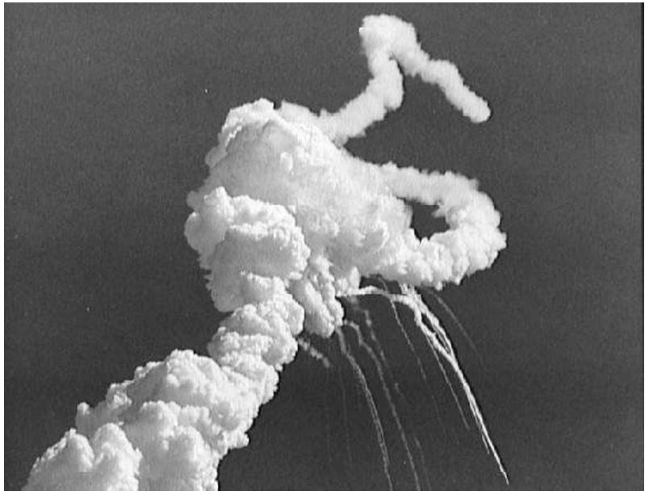
The Challenger Explosion
The explosion of the Challenger killed seven astronauts, including the first civilian in space, Christa McAuliffe. (Courtesy of NASA)

Slide 54
Case: Morton Thiokol/NASA
Challenger explosion
Roger Boisjoly and Morton Thiokol engineers documented dangers of low-temperature launches
Morton Thiokol executives and NASA officials overrode and hid concerns
Boisjoly shared information with Presidential commission
Morton Thiokol retaliated
Boisjoly took medical leave for stress, then quit
Found job as a consultant two years later

Slide 55
Case: Hughes Aircraft
Factory for military-grade hybrid chips
Some defective chips being approved
Ruth Goodearl reported incidents to upper management
Consequences for Goodearl
Harassed
Fired
Unemployment
Bankruptcy
Divorce
Goodearl and Ruth Aldred sued Hughes Aircraft under False Claims Act and won

Slide 56
Motives of Whistle-blowers
People become whistle-blowers for different reasons
Morality of action may depend on motives
Good motive
Desire to help the public
Questionable motives
Retaliation
Avoiding punishment

Slide 57
Corporate Response to Whistle-Blowing
Whistle-blowers are disloyal
Whistle-blowing has many harms
Bad publicity
Disruption of organization’s social fabric
Makes it hard for people to work as team
If company causes harm, public can use legal remedies to seek damages
Critique: Overly legalistic view of public harm?

Slide 58
Whistle-Blowing as Organizational Failure
Whistle-blowing harms organization
Bad publicity
Ruined careers
Erodes team spirit
Whistle-blowing harms whistle-blower
Retaliation
Estrangement
Organizations should improve communication
Critique
Is this realistic?
Robert Spitzer: Organizations should return to using principle-based ethics in decision making

Slide 59
Whistle-Blowing as Moral Duty
Richard DeGeorge’s questions for whistle-blowing
Is serious harm to the public at stake?
Have you told your manager?
Have you tried every possible inside channel?
Do you have persuasive documented evidence?
Are you sure whistle-blowing will work?
Under what conditions must you blow the whistle?
DeGeorge: If all five conditions are met
Others: If conditions 1-3 are met
Still others: Whistle-blowing is never morally required

Slide 60
Moral Responsibility
Exclusive Responsibilities
Role responsibility
Causal responsibility
Legal responsibility
Moral responsibility
Must be borne by people
Is not exclusive
Michael McFarland: A team should be held to a higher level of moral responsibility than any of its members

Slide 61
Summary
System administration, computer programming not yet formal, full-fledged professions like medicine or law
No certification and licensing required
However, computer professionals have responsible positions because their actions can harm public
Software Engineering Code of Ethics and Professional Practice an important tool, but good judgment still required
Organizations should have policies and procedures in place so good principles can be upheld and issues can be resolved without whistle-blowing

Slide 62

Copyright
This work is protected by United States copyright laws and is provided solely for the use of instructors in teaching their courses and assessing student learning. Dissemination or sale of any part of this work (including on the World Wide Web) will destroy the integrity of the work and is not permitted. The work and materials from it should never be made available to students except by instructors using the accompanying text in their classes. All recipients of this work are expected to abide by these restrictions and to honor the intended pedagogical purposes and the needs of other instructors who rely on these materials.

